Slide 1
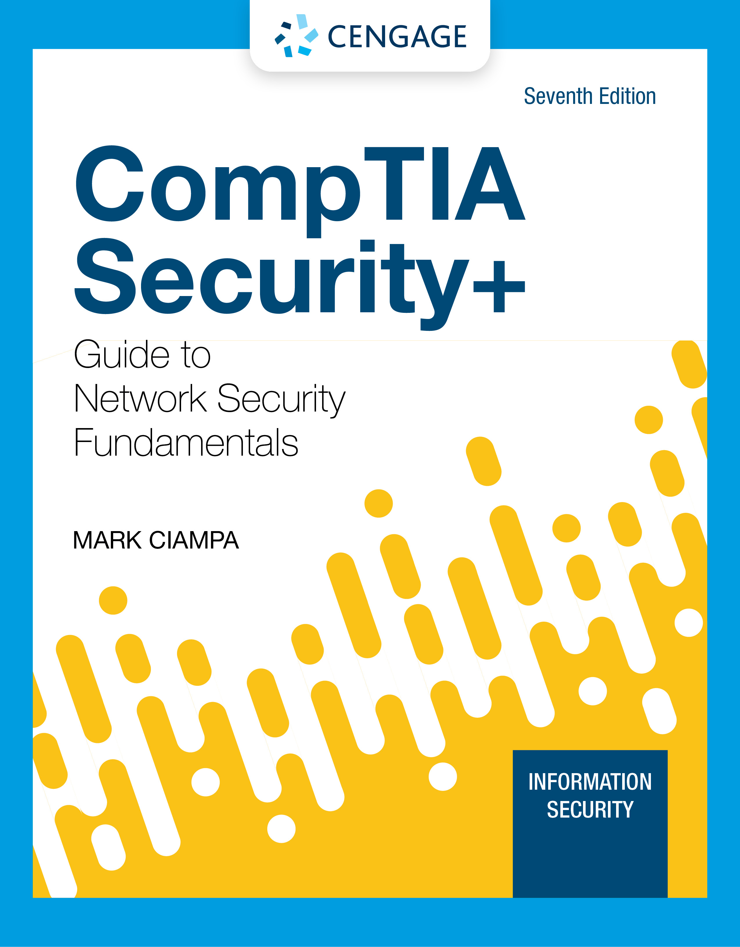
Module 4: Endpoint and Application Development Security
CompTIA Security+ Guide
to Network Security Fundamentals, 7th Edition

Slide 2
Module Objectives
By the end of this module, you should be able to:
1. Describe different threat intelligence sources
2. List the steps for securing an endpoint
3. Explain how to create and deploy SecDevOps

Slide 3
Threat Intelligence Sources
Organizations are now pooling resources and knowledge about the latest attacks with the broader security community
One type of shared information is the evidence of an attack
Key risk indicators (KRIs) are metrics of the upper and lower bounds of specific indicators of normal network activity
These indicators may include the total network logs per second, number of failed remote logins, network bandwidth, and outbound email traffic
A KRI exceeding its normal bounds could be an indicator of compromise (IOC)
An IOC shows that a malicious activity is occurring but is still in the early stages of an attack
IOC information aids others in their predictive analysis or discovering an attack before it occurs

Slide 4
Categories of Sources (1 of 3)
Two categories of threat intelligence sources are open source and closed source
Open Source Information
“open source” refers to anything that could be freely used without restrictions
Open source threat intelligence information is often called open source intelligence (OSINT)
Cyber Information Sharing and Collaboration Program (CISCP) enables actionable, relevant, and timely unclassified information exchange through partnerships
CISP services include:
Analyst-to-analyst technical exchanges
CISCP analytical products
Cross industry orchestration
Digital malware analysis

Slide 5
Categories of Sources (2 of 3)
Two concerns around public information sharing centers are:
Privacy – an organization that is the victim of an attack must be careful not to share proprietary or sensitive information when providing IOCs and attack details
Speed – Automated Indicator Sharing (AIS) enables the exchange of cyberthreat indicators between parties through computer-to-computer communication
Two tools facilitate AIS:
Structured Threat Information Expression (STIX) is a language and format used to exchange cyberthreat intelligence
Trusted Automated Exchange of Intelligence Information (TAXII) is an application protocol for exchanging cyberthreat intelligence over HTTPS

Slide 6
Categories of Sources (3 of 3)
Closed Source Information
Closed source is proprietary
Organizations that are participants in closed source information are part of private information sharing centers that restrict both access to data and participation
All candidates must go through a vetting process and meet certain criteria

Slide 7
Sources of Threat Intelligence (1 of 3)
Sources of threat intelligence that are useful:
Vulnerability database is a repository of known vulnerabilities and information as to how they have been exploited
Threat maps illustrate cyberthreats overlaid on a diagrammatic representation of a geographical area
File and code repositories are where victims of an attack can upload malicious files and software code that can be examined by others to learn more about the attacks and craft their defenses
Dark web – security professionals and organizations use the dark web on a limited basis to look for signs that information critical to that enterprise is being sought out or sold on the dark web

Slide 8
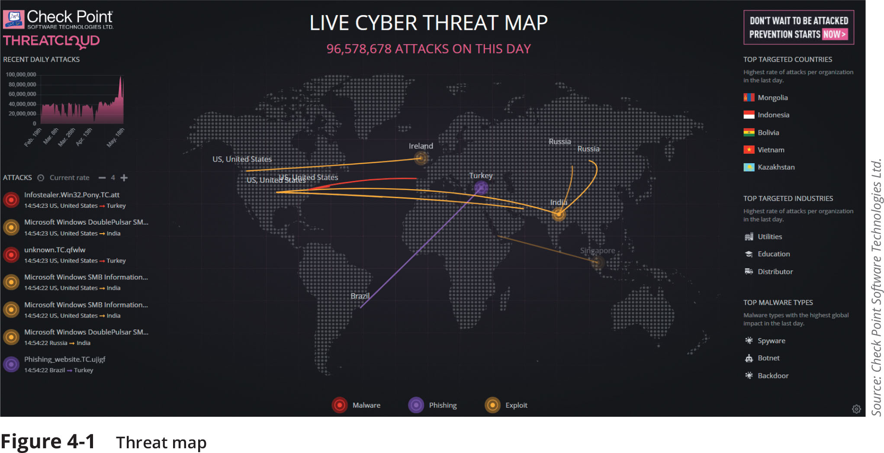
Sources of Threat Intelligence (2 of 3)
Figure 4-1 Threat map

Slide 9
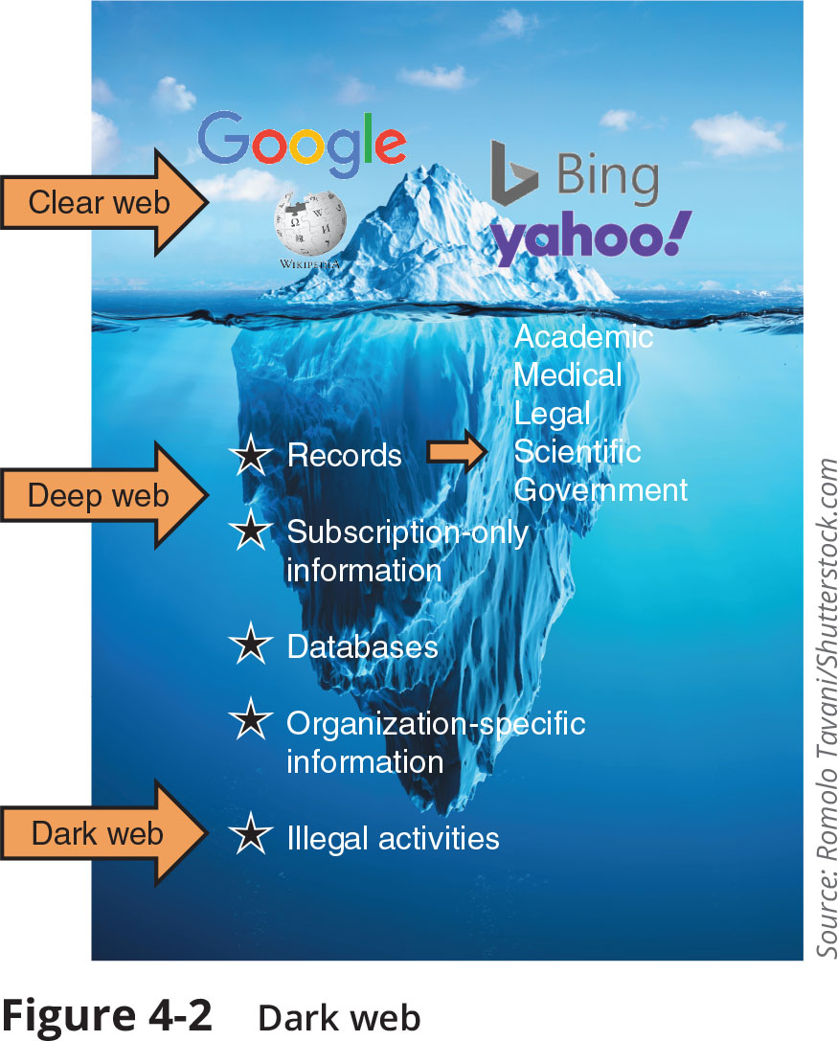
Sources of Threat Intelligence (3 of 3)
Figure 4-2 Dark web

Slide 10
Knowledge Check Activity 1
What is the significance of a KRI exceeding its normal bounds?
a. It must be referred to the DHS.
b. It could be an IOC.
c. It probably contains a TTP.
d. An AIS should be generated.

Slide 11
Knowledge Check Activity 1: Answer
What is the significance of a KRI exceeding its normal bounds?
Answer: b. It could be an IOC.
A key risk indicator (KRI) exceeding its normal bounds could be an indicator of compromise (IOC).

Slide 12
Securing Endpoint Computers
Securing endpoint computers primarily involves three major tasks:
Confirming that the computer has started securely
Protecting the computer from attacks
Hardening it for even greater protection

Slide 13
Confirm Boot Integrity (1 of 3)
Ensuring secure startup involves the Unified Extensible Firmware Interface (UEFI) and its boot security features
Unified Extensible Firmware Interface (UEFI)
Early booting processes used firmware called the BIOS (Basic Input/Output System)
To add functionality, an improved firmware interface was developed to replace BIOS
UEFI includes:
The ability to access hard drives that are larger than 2TB
Support for an unlimited number of primary hard drive partitions
Faster booting
Support for networking functionality in the UEFI firmware itself to aid in troubleshooting

Slide 14
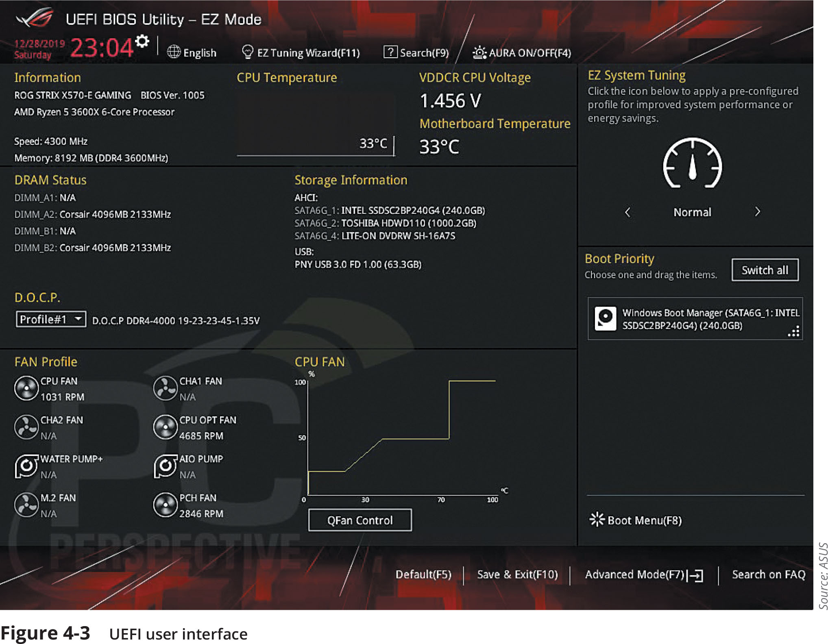
Confirm Boot Integrity (2 of 3)
Figure 4-3 UEFI user interface

Slide 15
Confirm Boot Integrity (3 of 3)
Boot Security
The ability to update the BIOS in firmware opened the door for a threat actor to create malware to infect the BIOS (called a BIOS attack)
Boot security involves validating that each element used in each step of the boot process has not been modified
This process begins with validation of the boot software, then it can validate the software drivers, and so on until control has been handed over to the OS
Called chain of trust because each element relies on the confirmation of the previous element to know that the entire process is secure
The strongest starting point is hardware, which cannot be modified like software (known as hardware root of trust)

Slide 16
Protect Endpoints (1 of 4)
Protection on computer endpoints can be accomplished through software installed on the endpoint, such as:
Antivirus software, antimalware, web browser protections, and monitoring and response systems
Antivirus
Antivirus (AV) software can examine a computer for file-based virus infections and monitor computer activity (such as scanning new documents that might contain a virus)
Log files created by AV products can provide beneficial info regarding attacks
Many AV products use signature-based monitoring, called static analysis
A newer approach to AV is heuristic monitoring, called dynamic analysis

Slide 17
Protect Endpoints (2 of 4)
Antimalware
Antimalware is a suite of software intended to provide protections against multiple types of malware
Antimalware spam protection is often performed using a technique called Bayesian filtering
Filters by analyzing every word in each email and determines how frequently a word occurs in a spam pile versus a nonspam pile
Another component of an antimalware suite is antispyware, which helps prevent computers from becoming infected by spyware
Uses pop-up blockers, which allow the user to select the level of blocking, ranging from blocking all pop-ups to allowing specific pop-ups

Slide 18
Protect Endpoints (3 of 4)
Web Browsers
Web browsers offer the following security on endpoint computers:
Secure cookies are sent to a web server with an encrypted request over the secure HTTPS protocol
This prevents an unauthorized person from intercepting a cookie that is being transmitted between the browser and the web server
HTTP Response Header are headers that tell the browser how to behave while communicating with the website

Slide 19
Protect Endpoints (4 of 4)
Monitoring and Response Systems
There are three types of monitoring and response systems for endpoint computers:
Host Intrusion Detection Systems (HIDS) is a software-based application that runs on an endpoint computer and can detect an attack has occurred
Host Intrusion Prevention Systems (HIPS) monitor endpoint activity to immediately block a malicious attack by following specific rules
Endpoint Detection and Response (EDR) tools are considered more robust than HIDS and HIPS
An EDR can aggregate data from multiple endpoint computers to a centralized database
EDR tools can perform more sophisticated analytics that identify patterns and detect anomalies

Slide 20
Harden Endpoints (1 of 6)
Hardening endpoints involves patch management and OS protections
Patch Management
Effective patch management involves two types of patch management tools to administer patches
Patch distribution using an automated patch update service
Patch reception in Microsoft Windows 10 includes the following options:
Forced updates
No selective updates
More efficient distribution

Slide 21
Harden Endpoints (2 of 6)
Operating Systems
Securing an OS involves proper security configurations and using confinement tools
A typical OS security configuration should include the following:
Disabling unnecessary ports and services
Disabling default accounts/passwords
Employing least functionality
In Microsoft Windows, a security template is a collection of security configuration settings that can be used to deploy security settings to multiple computers
Windows 10 Tamper Protection security feature prevents Windows security settings from being changed or disabled by a threat actor who modifies the registry
A Group Policy setting can also prevent access to registry editing tools (see Figure 4-7)

Slide 22
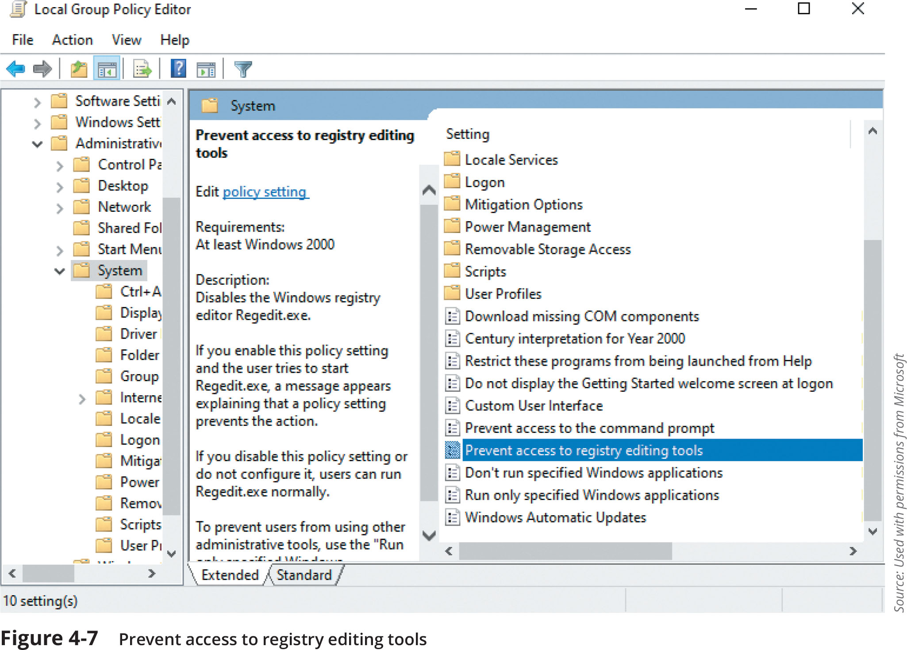
Harden Endpoints (3 of 6)
Figure 4-7 Prevent access to registry editing tools

Slide 23
Harden Endpoints (4 of 6)
Operating Systems (continued)
Confinement Tools – several tools can be used to restrict malware:
Application whitelisting/blacklisting
Sandbox
Quarantine

Slide 24
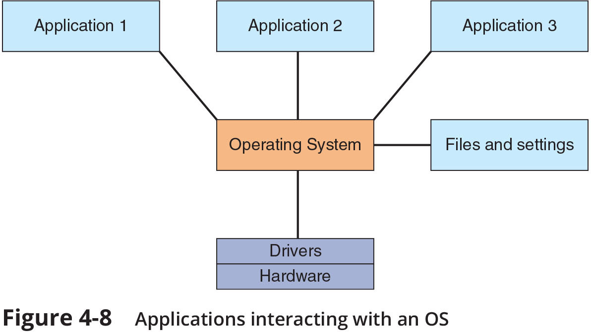
Harden Endpoints (5 of 6)
Figure 4-8 Applications interacting with an OS

Slide 25
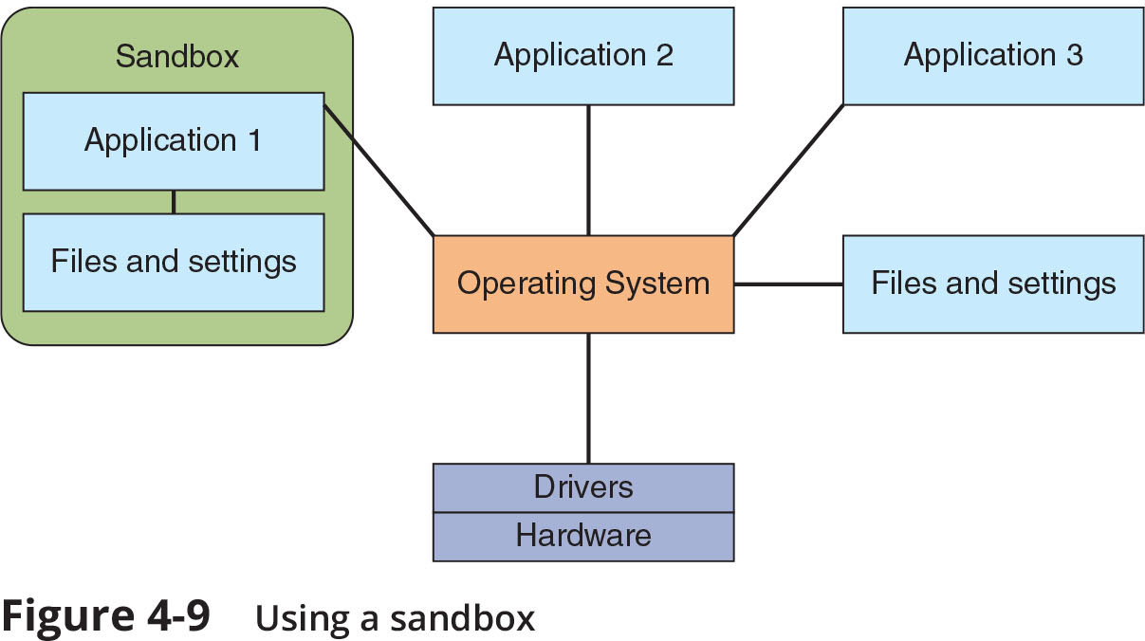
Harden Endpoints (6 of 6)
Figure 4-9 Using a sandbox

Slide 26
Knowledge Check Activity 2
Which of the following is NOT a tool that can be used to confine or restrict malware?
a. Whitelisting
b. Quarantine
c. Sandbox
d. Legacy boot

Slide 27
Knowledge Check Activity 2: Answer
Which of the following is NOT a tool that can be used to confine or restrict malware?
Answer: Legacy boot
A computer configured for legacy boot uses the BIOS to boot the system, which has little or no security features.

Slide 28
Creating and Deploying SecDevOps (1 of 2)
An unsecure application can open the door for attackers to exploit the application, the data that it uses, and even the underlying OS
A directory traversal attack takes advantage of vulnerability in the web application program or the web server software so that a user can move from the root directory to other restricted directories
The ability to move could allow an unauthorized users to view confidential files or enter commands to execute on a server known as command injection
Other dangerous weaknesses in an application can create vulnerabilities in computer memory or buffer areas that can be easily exploited
Poor memory management vulnerabilities result in attacks such as buffer overflow, integer overflow, pointer/object deference, and DLL injection attacks

Slide 29
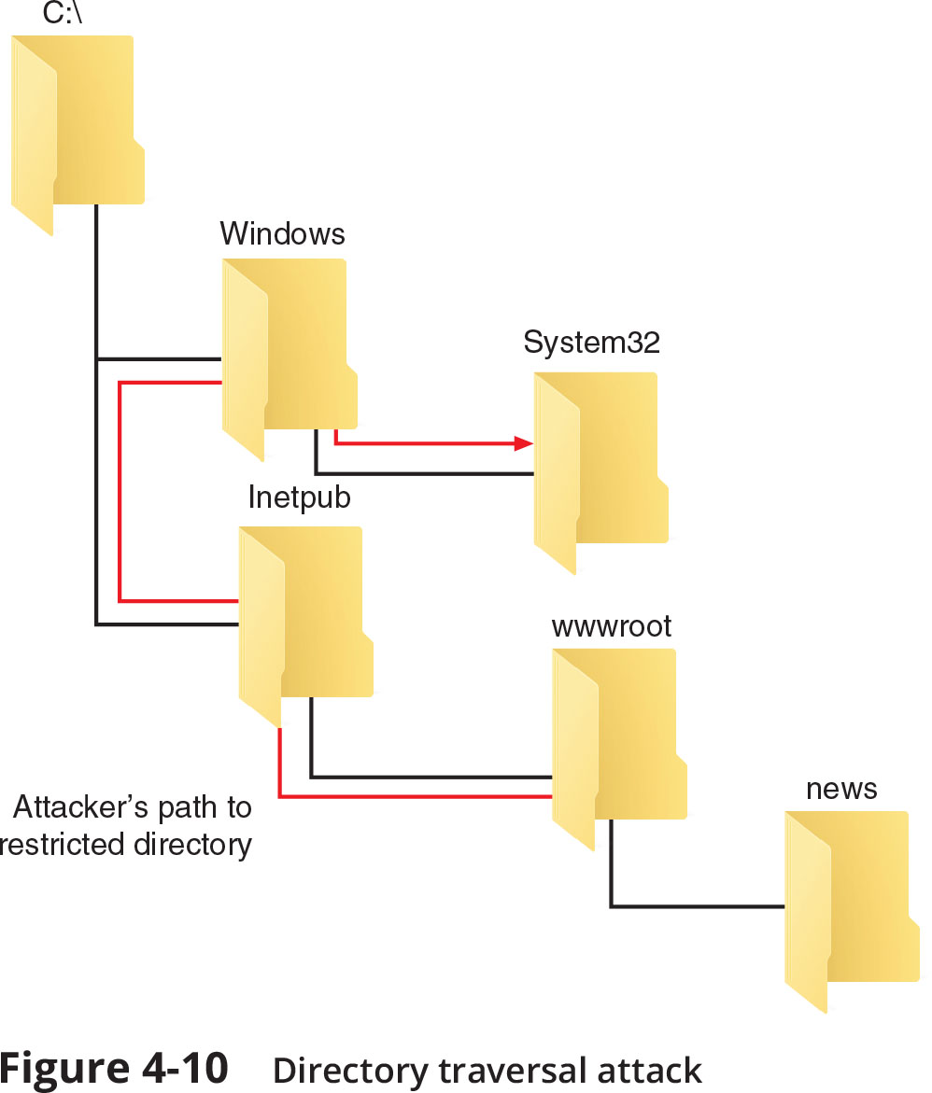
Creating and Deploying SecDevOps (2 of 2)
Figure 4-10 Directory traversal attack

Slide 30
Application Development Concepts (1 of 3)
The two levels of application development concepts include general concepts that apply to all application development and those that apply to a rigorous security-based approach
General Concepts
Developing an application requires completing the following stages:
Development
Testing
Staging
Production
Software diversity is a software development technique in which two or more functionally identical variants of a program are developed from the same specification but by different programmers or programming teams
The intent is to provide error detection, increased reliability, and additional documentation

Slide 31
Application Development Concepts (2 of 3)
General Concepts (continued)
Provisioning is the enterprise-wide configuration, deployment, and management of multiple types of IT system resources
Deprovisioning in application development is removing a resource that is no longer needed
Integrity measurement is an “attestation mechanism” designed to be able to convince a remote party that an application is running only a set of known and approved executables
SecDevOps
An application development lifecycle model is a conceptual model that describes the stages involved in creating an application and are usually one of the following two:
Waterfall model – uses a sequential design process
Agile model – takes an incremental approach

Slide 32
Application Development Concepts (3 of 3)
SecDevOps (continued)
SecDevOps is the process of integrating secure development best practices and methodologies into application software development and deployment processes using the agile model
SecDevOps applies automated courses of action to develop code as quickly and securely as possible
This automation enables:
Continuous monitoring
Continuous validation
Continuous integration
Continuous delivery
Continuous deployment

Slide 33
Secure Coding Techniques
Several coding techniques should be used to create secure applications and limit data exposure or disclosing sensitive data to attackers
These techniques include:
Determining how encryption will be implemented
Ensuring that memory management is handled correctly so as not to introduce memory vulnerabilities

Slide 34
Code Testing (1 of 3)
Testing is one of the most important steps in SecDevOps
Testing should be performed during the implementation and verification phases of a software development process
Testing involves static code analysis and dynamic code analysis
Static Code Analysis
Static code analysis are tests ran before the source code is even compiled and may be accompanied by manual peer reviews
Dynamic Code Analysis
Security testing performed after the source code is compiled is called dynamic code analysis
Fuzzing is used by dynamic code analysis tools and provides random input to a program in an attempt to trigger exceptions

Slide 35
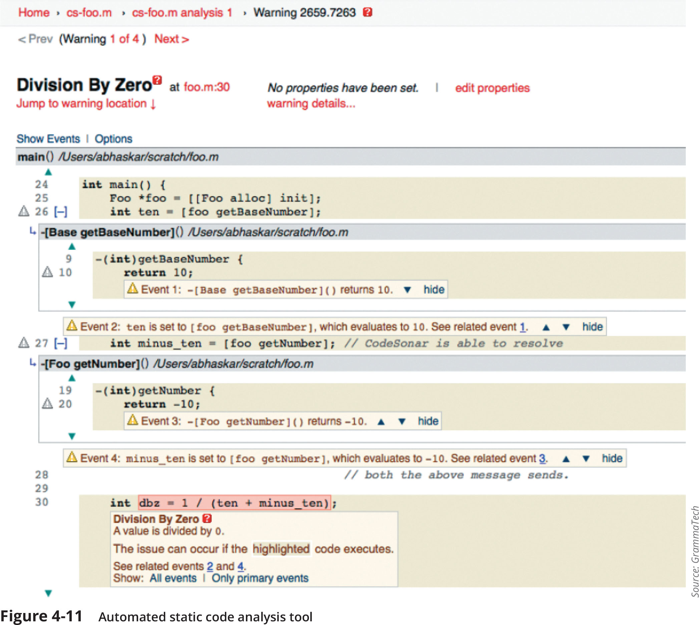
Code Testing (2 of 3)
Figure 4-11 Automated static code analysis tool

Slide 36
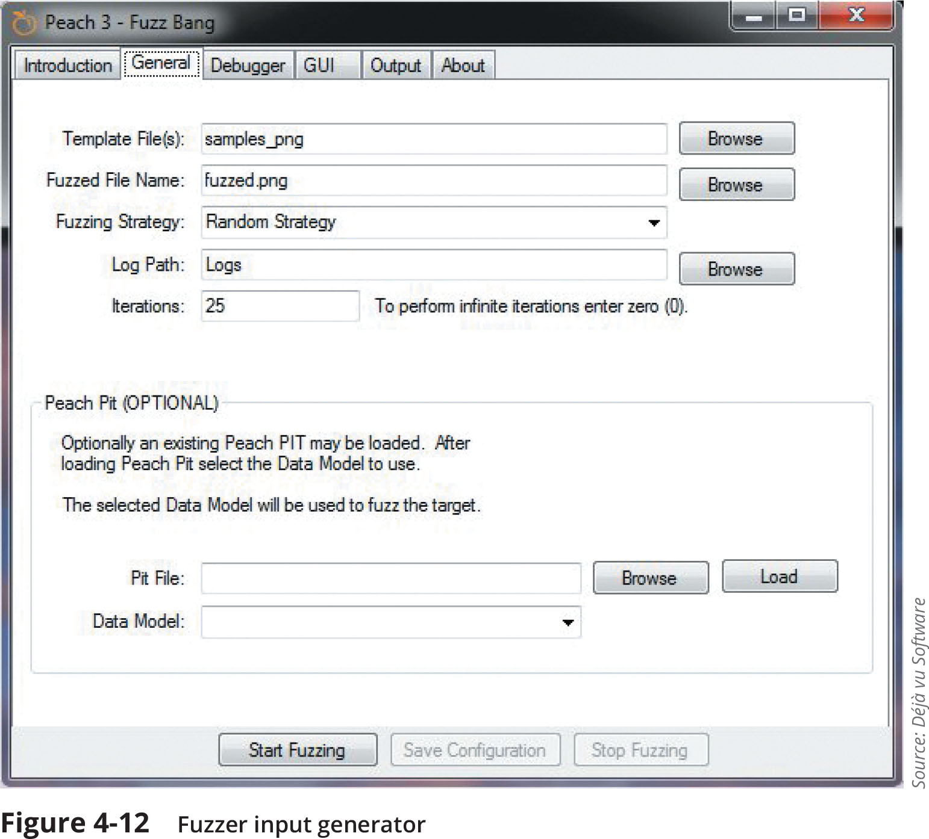
Code Testing (3 of 3)
Figure 4-12 Fuzzer input generator

Slide 37
Knowledge Check Activity 3
Which of the following best describes static code analysis?
a. Testing uses a suite of pre-built attacks.
b. Tests are run before the source code is compiled.
c. Random input is used to trigger exceptions.
d. Used after all components are integrated.

Slide 38
Knowledge Check Activity 3: Answer
Which of the following best describes static code analysis?
Answer: b. Tests are run before the source code is compiled.
Static code analysis is performed before the source code is compiled and may be accompanied by manual peer reviews. Dynamic code analysis is performed on a running system.

Slide 39
Self-Assessment
Consider the importance of the system boot process in the security of endpoint computers. What are some of the dangers of using legacy boot procedures? Why are computers that use legacy boot firmware more susceptible to attacks?

Slide 40
Summary (1 of 2)
Organizations are pooling their experiences and knowledge gained about the latest attacks with the broader security community because sharing this type of information has become an important aid to help other organizations shore up their defenses
Several sources of threat intelligence are useful: a vulnerability database, a cybersecurity threat map, and file and code repositories are examples
One of the steps that is often overlooked in securing endpoint computers is to confirm that the computer has started without any malicious activity taking place
Antivirus (AV) software can examine a computer for any file-based virus infections and monitor computer activity and scan new documents that might contain a virus
Web browsers have a degree of security that can protect endpoint computers
A host intrusion detection system (HIDS) is a software-based application that runs on an endpoint computer and can detect that an attack has occurred

Slide 41
Summary (2 of 2)
One of the most important steps in securing an endpoint computer is to promptly install patches
An unsecure application can open the door for attackers to exploit the application, the data that it uses, and even the underlying OS
Testing is one of the most important steps in SecDevOps

